Slide 1
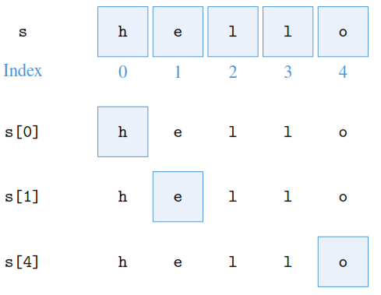
Indexing
hello
s = ‘hello’
>>> s[0]
'h'
>>> s[1]
'e'
>>> s[4]
'o'
01234

Slide 2
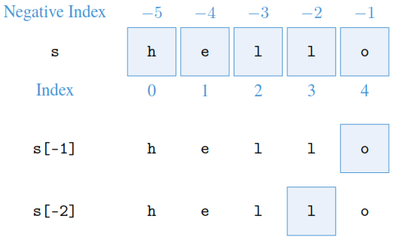
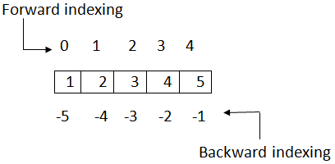
Negative indexing in python
Negative indexes may be used to access the characters from the back (right side) of the string. For example, the last character and second to last can be retrieved using negative indexes 1 and 2, respectively .
>>> s[-1]
'o'
>>> s[-2]
'l'
hello
-5-4-3-2-1

Slide 3
Executing list operations & Functions
The length of a list (i.e., the number of items in it) is computed using function len():
>>>len(pets)
3
Like strings, lists can be added, meaning that they can be concatenated. They can also be multiplied・by an integer k, which means that k copies of the list are concatenated:
>>> pets + pets
['goldfish', 'cat', 'dog', 'goldfish', 'cat', 'dog']
>>> pets * 2
['goldfish', 'cat', 'dog', 'goldfish', 'cat', 'dog']

Slide 4
Executing list operations & Functions
If you want to check whether string 'rabbit' is in the list, you can use the in operator
in a Boolean expression that evaluates to True if string 'rabbit' appears in list pets:
>>> 'rabbit' in pets
False
>>> 'dog' in pets
True

Slide 5
Executing list operations & Functions
We summarize the usage of some of the string operators. We include in the table functions min(), max(), and sum(), which can take a list as input and return the smallest item, the largest item, or the sum of the items, respectively, in the list:
>>> lst = [23.99, 19.99, 34.50, 120.99]
>>>min(lst)
19.99
>>>max(lst)
120.99
>>>sum(lst)
199.46999999999997

Slide 6
Assignment # 1
To be submitted by solving it on jupyter notebook & email it to me.

Slide 7
Practice problem 2.5
Start by executing the assignment:
s = '0123456789'
Now write expressions using string s and the indexing operator that evaluate to:
(a) '0'
(b) '1'
(c) '6'
(d) '8'
(e) '9'

Slide 8
Practice problem 2.6
words = ['bat', 'ball', 'barn', 'basket', 'badminton']
Now write two Python expressions that evaluate to the ﬁrst and last, respectively, word in
words, in dictionary order.

Slide 9
Practicing data types in python programming
Lecture 6

Slide 10
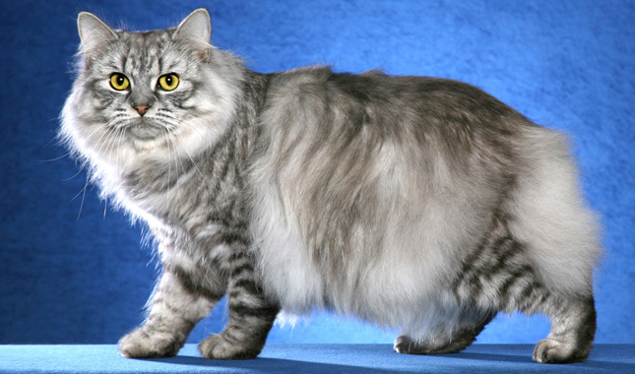
Lists are mutable
Some objects are mutable, meaning they can be altered.
Others are immutable; they cannot be changed but rather return new objects when attempting to update.
>>> pets
['goldfish', 'cat', 'dog']
We would like pets[1] to evaluate to 'cymric cat' instead of just plain 'cat'. To do this, we assign 'cymric cat' to pets[1]:
>>> pets[1] = 'cymriccat '
>>> pets
['goldfish', 'cymriccat ', 'dog']
So, the list no longer contains the string 'cat' at index 1; instead, it contains the string 'cymric cat'.

Slide 11
Strings are immutable
While lists are mutable, strings are not. What that means is that we cannot change the individual characters of a string value. For example, suppose that we misspelled the type of cat:
>>> myCat = 'cymricbat '
We would like to correct the mistake by changing the character at index 7 from a 'b' to a 'c'. Let’s try:
>>> myCat[7] = 'c'
Traceback (most recent call last):
File "<pyshell#35>" , line 1,in<module>

Slide 12
Error if values are inserted in string
myCat[7] = 'c'
TypeError: 'str' object doesnot support item assignment
The error message essentially says that individual characters (items) of a string cannot be changed (assigned to). We say that strings are immutable. Does that mean that we are stuck with a misspelled value for myCat? No, not at all. We can simply reassign a brand new value to variable myCat:
>>> myCat = 'Cymric Cat '
>>> myCat
‘Cymric Cat '

Slide 13
Tuples, or “Immutable Lists”
Python also supports tuples which, in many ways, behave like lists except that tuples are immutable. A tuple object contains a sequence of values separated by commas and enclosed in parentheses (( )) instead of brackets ([ ]):
>>> days = ('Mo', 'Tu', 'We')
>>> days
('Mo', 'Tu', 'We')
The parentheses are optional in simple expressions like this assignment:
>>> days = 'Mo', 'Tu', 'We', 'Th'
>>> days
('Mo', 'Tu', 'We', 'Th')

Slide 14
Working with tuples
>>> 'Fr' in days
False
>>> week = days + ('Fr', 'Sa', 'Su')
>>> week
('Mo', 'Tu', 'We', 'Th', 'Fr', 'Sa', 'Su')
>>>len(week)
7
>>> 2*week
('Mo', 'Tu', 'We', 'Th', 'Fr', 'Sa', 'Su', 'Mo', 'Tu', 'We', 'Th','Fr', 'Sa', 'Su')

Slide 15
In particular, the indexing operator can be used to access tuple items using the item’s oﬀset as the index, just like in lists:
>>> days[2]
'We'
However, any attempt to change a tuple results in an error:
>>> days[4] = 'th'
Trace back (most recent call last):
File "<pyshell#261>" , line 1,in<module>
days[4] = 'th'
Type Error: 'tuple' object does not support item assign.
So, as in lists, items in tuples are ordered and can be accessed using an index (oﬀset). Unlike lists, tuples are immutable: once a tuple is created, it cannot be changed.

Slide 16
List and tuple methods
There are also functions that are called on lists. For example, to add 'guinea pig' tolist pets, we would call function append() on list pets as follows:
>>> pets.append(‘duck ')
>>> pets
['goldfish', 'cat ', 'dog', ‘duck']
Let’s do this again and add another 'dog' to list pets:
>>> pets.append('dog')
>>> pets
['goldfish', 'cat ', 'dog', ‘duck ', 'dog']
Note the special way the function append() is called:

Slide 17
List methods
Explanation | Usage
Adds item to the end of list lst | lst.append(item)
Returns the number of occurrences of item in list lst | lst.count(item)
Returns the index of the ﬁrst occurrence of item in list lst | lst.index(item)
Inserts item into list just before index index | lst.insert(index, item)
Removes last item in the list | lst.pop()
Removes ﬁrst occurrence of item in the list | lst.remove(item)
Reverses the order of items in the list | lst.reverse()
Sorts the list | lst.sort()

Slide 18
Executing functions of list
pets =['goldfish', 'cat', 'dog']
pets.append(‘duck ')
pets.append(‘dog ')
print(pets)
['goldfish', 'cat', 'dog‘, ‘duck’, ‘dog’]
pets.count('dog')
2
pets.remove('dog')
print(pets)
['goldfish', 'cat ', 'duck', 'dog']
pets.reverse()
print(pets)
[‘dog’, ‘duck’, ‘cat’, ‘goldfish’]
pets.sort()
print(pets)
[‘cat’, ‘dog’, ‘duck’, ‘goldfish’]

Slide 19
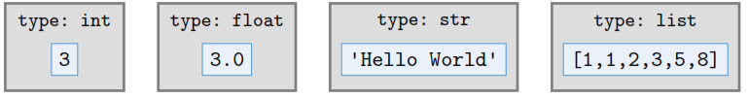
Type object
Every object has associated with it a type and a value. Four objects: an integer object with value 3, a ﬂoating point object with value 3.0, a string object with value 'Hello World', and a list object with value [1, 1, 2, 3, 5, 8].
An object’s type indicates what kind of values the object can hold and what kind of operations can be performed on the object. The types we have seen so far include the integer (int), ﬂoating point (float), Boolean (bool), string (str), and list (list) types.

Slide 20
Type()
Python type() function can be used to determine an object’s type:
>>>type(3)
<class 'int'>
>>>type(3.0)
<class 'float'>
>>>type( 'HelloWorld ')
<class 'str'>
>>>type([1, 1, 2, 3, 5, 8])
<class 'list'>
When used on a variable, the type() function will return the type of the object the variable refers to:
>>> a = 3
>>>type(a)
<class 'int'>

Slide 21
Small quiz
What do you understand by class and objects? Give Examples
What is the difference between List and Tuple? Give Examples

Slide 22
Assignment # 1
To be submitted by solving it on jupyter notebook & email it to me.

Slide 23
Practice problem 2.7
Given the list of student homework grades
>>> grades = [9, 7, 7, 10, 3, 9, 6, 6, 2]
write:
(a)An expression that evaluates to the number of 7 grades
(b)A statement that changes the last grade to 4
(c)An expression that evaluates to the maximum grade
(d)A statement that sorts the list grades
(e)An expression that evaluates to the average grade

Slide 24
Practice problem 2.7
In what order are the operators in the following expressions evaluated?
(a) 2 + 3 == 4 or a >= 5
(b) lst[1] * -3 < -10 == 0
(c) (lst[1] * -3 < -10) in [0, True]
(d) 2 * 3**2
(e) 4 / 2 in [1, 2, 3]

Slide 25
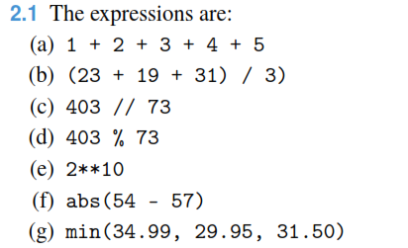
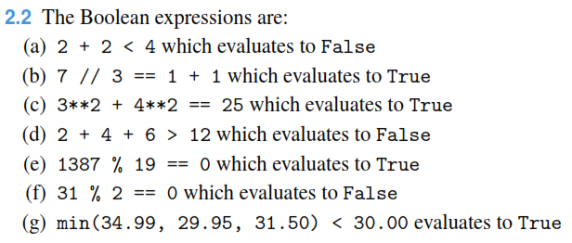
Complete problem sets to solve – To be submitted on Monday (22-Oct-2018) in hard copy (code + output)

Slide 26
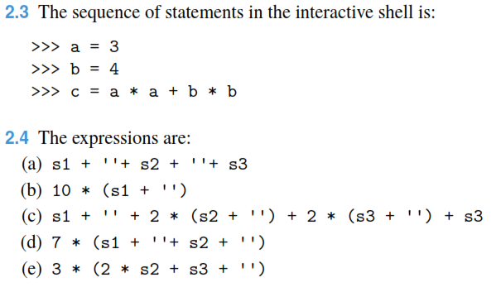
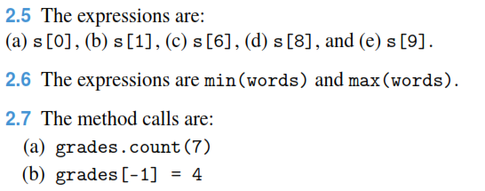

Complete problem sets to solve

Slide 27
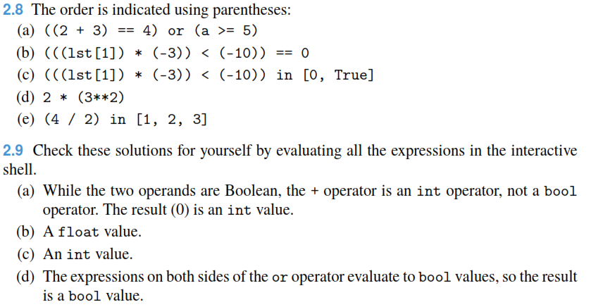
Complete problem sets to solve

Slide 28
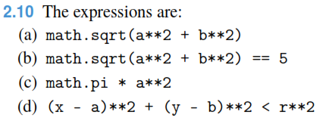
Complete problem sets to solve

